Slide 1
Welcome to CS149 Students to….
THE FOURTH HOUR
TOPIC - Computer Programming
Notes:
While students are filtering in, circulate a piece of paper for students to write their names on. Include a place for name and professor. If a student came in late, note what time they came in so that we can accurately track data. (The observing TA should probably be the one to manage and record when a student comes in late)

Slide 2
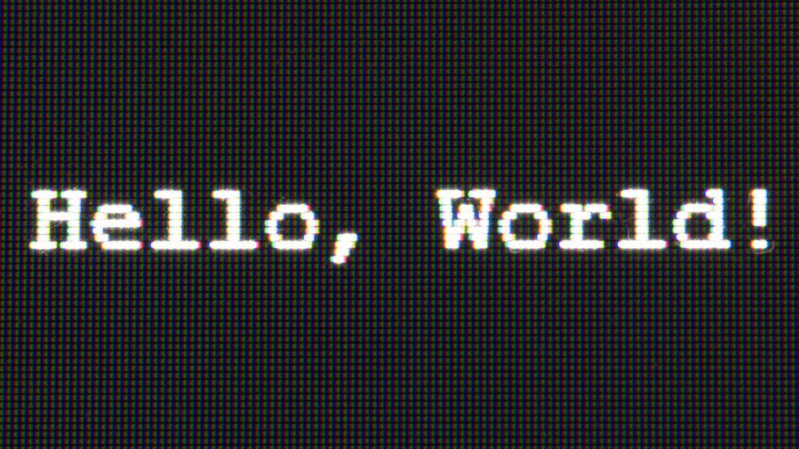
Introductions
Name
Professor
Fun Fact About yourself
Notes:
Welcome to the Fourth Hour! My name is _______ and I will be the TA running the CS149 Fourth Hour Study Sessions every (day of week). Now, since many of us probably have different professors and are in different sections of CS149 I thought it would be fun for us to introduce ourselves. For the fun fact you can say literally whatever you want! It doesn’t have to be CS related, it can be a hobby, what’s your favorite animal, food, have you traveled anywhere fun recently. Whatever you want! I’ll go first. (Go around the room and have students introduce themselves).

Slide 3
This week in class we learned about...
This week in class we learned about the structure of code in java.

Slide 4
This week in class we learned about...
This week in class we learned about the structure of code in java.
public class ReviewSession {
public static void main(String args[])
{
int welcome;
double csStudents;
System.out.print(“Welcome to the First Review Session!”);
}
}
Notes:
Which looks something like this.

Slide 5
This week in class we learned about...
Java is an Object oriented language in which we can create programs using classes, methods, variables, and objects.
public class ReviewSession {
public static void main(String args[])
{
int welcome;
double csStudents;
System.out.print(“Welcome to the First Review Session!”);
}
}
Notes:
Which looks something like this. We will learn more about the specific features of Java later, but it is good to understand the basic structure of a Java Program especially when coding for labs and HW problems.

Slide 6
Let’s do a quick activity!
In groups of 2 label the code snippet on the following page using vocab words provided
With your partner discuss in your own words what that vocab word means to you in terms of computer science

Slide 7
Let’s do a quick activity!
public class ReviewSession {
public static void main(String args[])
{
int welcome;
double csStudents;
System.out.print(“Welcome to the First Review Session!”);
}
}
VOCAB WORDS
integer declaration
print statement
main method
class
decimal value declaration
Notes:
Give students 3-5 min to work on this activity.

Slide 8
Let’s do a quick activity!
public class ReviewSession { //class
public static void main(String args[]) //main method
{
int welcome; //integer declaration
double csStudents; //decimal value declaration
System.out.print(“Welcome to the First Review Session!”); //print statement
}
}
Notes:
Go over answers one by one and ask students their definition that they came up with for the vocab term.

Slide 9
Variable Types in Java
Java is a typed language.

Slide 10
Variable Types in Java
Java is a typed language.
before we create a variable, we have to give it a type first. This gives a hint to our compiler telling it what to expect the variable to be.

Slide 11
Variable Types in Java
Java is a typed language.
before we create a variable, we have to give it a type first. This gives a hint to our compiler telling it what to expect the variable to be.
An example of a typed language case in Java is if we want to create a number object we have to use the type int.
int num = 5;

Slide 12
Variable Types in Java
Java is a typed language.
before we create a variable, we have to give it a type first. This gives a hint to our compiler telling it what to expect the variable to be.
An example of a typed language case in Java is if I want to create a number I have to use the type int.
int num = 5;
Types in Java are like a contract, we are promising our program the right side will agree/fit into the left side.
Notes:
Write some examples on the whiteboard and ask students if certain values will fit into a specific variable type.

Slide 13
Socrative Question 1
Go to https://b.socrative.com/login/student
Classroom name: FOURTHOUR

Slide 14
Socrative Question 1
Which of the following are correct declaration of a decimal variable named num:
Double num;
double num;
DOUBLE num;
1
2
1 and 2
All of the Above

Slide 15
Socrative Question 1
Which of the following are correct declaration of a decimal variable named num:
Double num;
double num;
DOUBLE num;
1
2
1 and 2
All of the Above
Notes:
Java is not only a typed language, but it is also a case-sensitive language. This means that uppercase and lowercase matter to the computer.

Slide 16
Variable Types Game
All real numbers :

Slide 17
Variable Types Game
All real numbers : double

Slide 18
Variable Types Game
All real numbers : double
Whole numbers:
Notes:
They went over double and int in class. String and char might be new to some of them (it was briefly mentioned in the chapter but there was no code that contained it). Let them know that is ok, they will be learning more able those types next week.

Slide 19
Variable Types Game
All real numbers : double
Whole numbers: int

Slide 20
Variable Types Game
All real numbers : double
Whole numbers: int
Letter in single quotes:

Slide 21
Variable Types Game
All real numbers : double
Whole numbers: int
Letter in single quotes: char

Slide 22
Variable Types Game
All real numbers : double
Whole numbers: int
Letter in single quotes: char
Multiple letters in double quotes:

Slide 23
Variable Types Game
All real numbers : double
Whole numbers: int
Letter in single quotes: char
Multiple letters in double quotes: String

Slide 24
Socrative Question 2
How would you best describe the following:
int number;
Java statement that declares a variable
Java statement that assigns a variable
Java statement that doesn’t create memory allocation
An incorrect Java statement

Slide 25
Socrative Question 2
How would you best describe the following:
int number;
Java statement that declares a variable
Java statement that assigns a variable
Java statement that doesn’t create memory allocation
An incorrect Java statement

Slide 26
Socrative Question 3
Which of the following statements causes the computer to store variable information
in memory:
int num;
num = 100;
double x = 10.0;
1 and 2
2 and 3
Only 3
All of the Above

Slide 27
Socrative Question 3
Which of the following statements causes the computer to store variable information
in memory:
int num;
num = 100;
double x = 10.0;
1 and 2
2 and 3
Only 3
All of the Above

Slide 28
What is Concatenation?
Java also allows us to concatenate strings and variables together. This can be very helpful if we want to put multiple strings together.

Slide 29
What is Concatenation?
public class ReviewSession {
public static void main(String args[])
{
String greeting = “Hi my name is”;
String name = “Megan”;
System.out.print(greeting + “ “ + name);
}
}
Notes:
Ask students how they

Slide 30
Try it yourself
public class ReviewSession {
public static void main(String args[])
{
String greeting = “Hi my name is”;
String name = “Megan”;
String month = “August”;
int day = 15;
int year = 1997;
//print Hi my name is _____.
//I was born on month day, year.
System.out.print(greeting + “ “ + name);
}
}
//print Hi my name is _____.
//I was born on month day, year.
You can use the following code for reference:
Notes:
Have students work on this activity for 3-5 min (maybe have them write answers on the white board.

Slide 31
Possible Solution
public class ReviewSession {
public static void main(String args[])
{
String greeting = “Hi my name is”;
…..
System.out.print(greeting + “ “ + name);
System.out.print(“\n”);
System.out.print(“I was born on “ + month + “ “ + day + “, “ + year + “.”);
}
}
Notes:
Have students talk about other possible solutions

Slide 32
Questions?

